Slide 1

Unit 2: Lesson 4 A true dandy

Slide 2
Task 1: Match the parts of Oscar Wilde’s famous quotations.
4
1
6
3
2
5

Slide 3
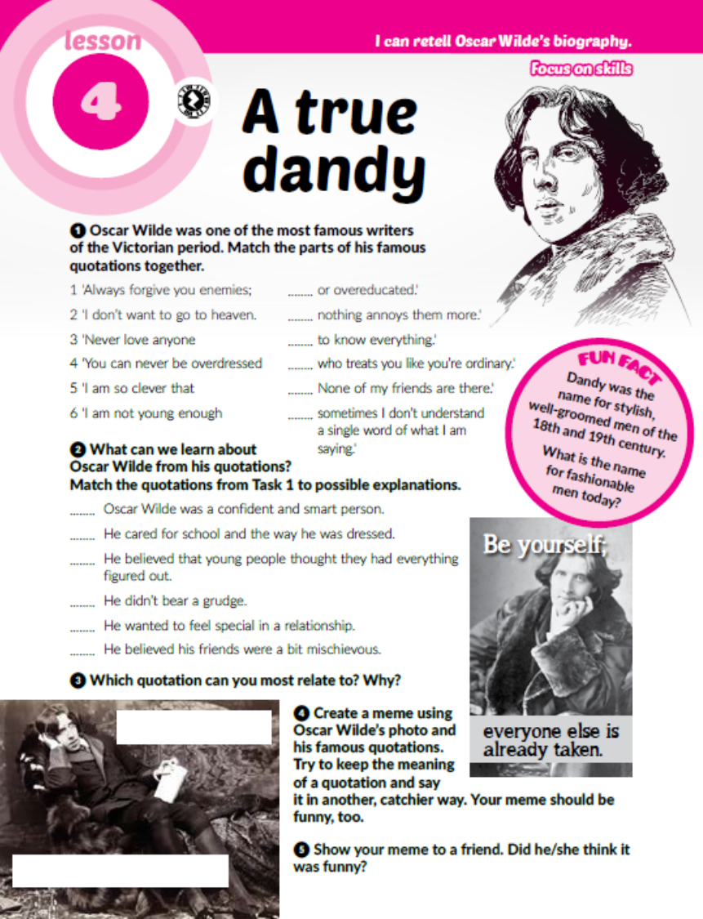
Task 2: What can we learn about Oscar Wilde from his quotations? Match the quotations from Task 1 to possible explanations.
Task 3: Which quotation can you most relate to? Why?
5
4
6
1
3
2

Slide 4

Task 4: Create an Oscar Wilde meme using his picture and one of his qotations.

Slide 5
Task 6: Listen to Oscar Wilde’s biography and sort out the events in the table.
https://www.e-sfera.hr/dodatni-digitalni-sadrzaji/4a8497d4-f262-41f7-a0e0-edc2bece0cbf/
editor = urednik
high society = visoko društvo
imprisoned = zatvoren, zatočen
attend college = pohađati fakultet
exile = izgnanstvo
novel = roman
play = drama
born, attended college
climbed into high society, got married, had two sons, worked as an editor, wrote novels and plays, imprisoned
lived in exile, died, buried

Slide 6
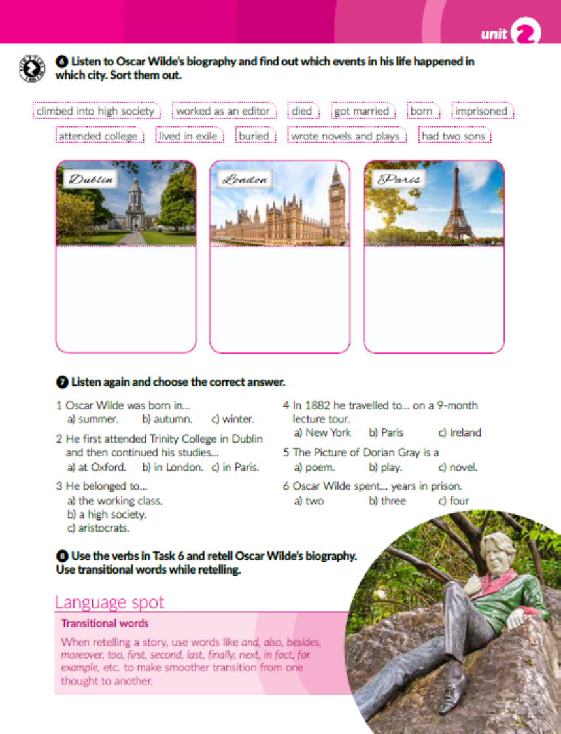

Task 7: Listen again and choose the correct answer.
https://www.e-sfera.hr/dodatni-digitalni-sadrzaji/4a8497d4-f262-41f7-a0e0-edc2bece0cbf/

Slide 7

Task 8: Use the verbs in Task 6 to retell Oscar Wilde’s biography.

Slide 8
workbook, page 37
Task 1: Complete the biography with the past simple of the verbs in brackets.
attended
showed
got
graduated
moved
started
began
set
married
had
worked
wrote
published
was
accused
denied
lead
sentenced
became
died

Slide 9
Task 2: Put the words in the correct order.
The truth is rarlely pure and never simple.
Hearts are made to be broken.
True friends stab you in the front.
When the gods wish to punish us, they answer our prayers.

Slide 10
Task 3: Use the Internet and match the writers to their works.
Task 4: Tick the books in Task 3 you have read.
14
6
10
18
1
9
16
2
17
5
8
12
15
4
11
7
13

Slide 11

PLAY AND LEARN!
https://wordwall.net/play/18897/957/719

